Slide 1
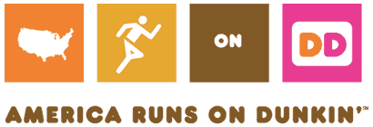
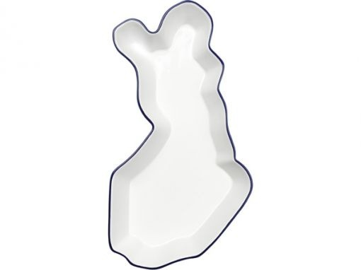
Dunkin’ Donuts in Finland
Finland
Will Briand, Brittney McDonald, Caitlyn Morral, Mackenzie Watson

Slide 2
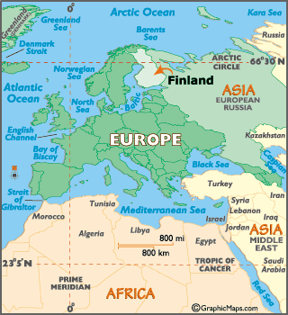
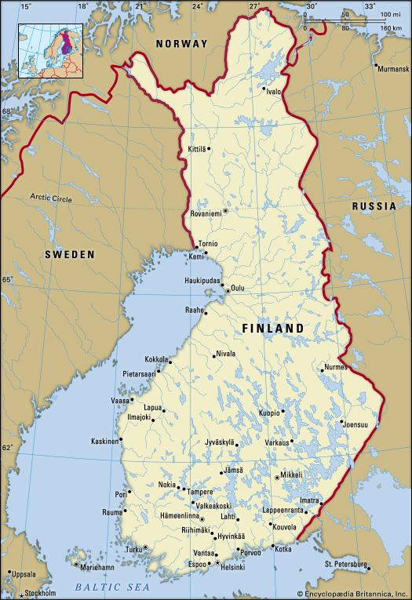

Slide 3
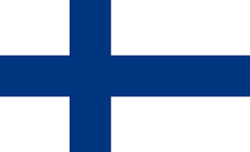
Finland
Geography: Bordered by Norway, Sweden and Russia, Finland is one of world’s most northern and remote countries. Woodlands cover ⅔ of the land and they are known to have severe climates.
Economy: Is known to be open and transparent.
Population: 5.5 million
GDP: 225 billion
Unemployment: 9.6%
Culture: Strong sense of national identity.
Language is Finnish, although 5.6% speak Swedish and 8,000 people speak native Saami
High degree of gender equality
Verbal agreements and promises are considered binding.
The world’s leading coffee consumer country.
Religion: 83 % Evangelical-Lutheran, 1.1% Finnish Orthodox Church.

Slide 4
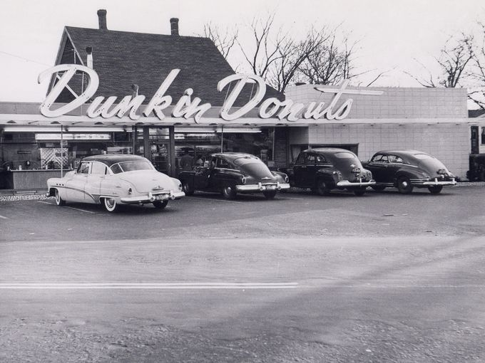
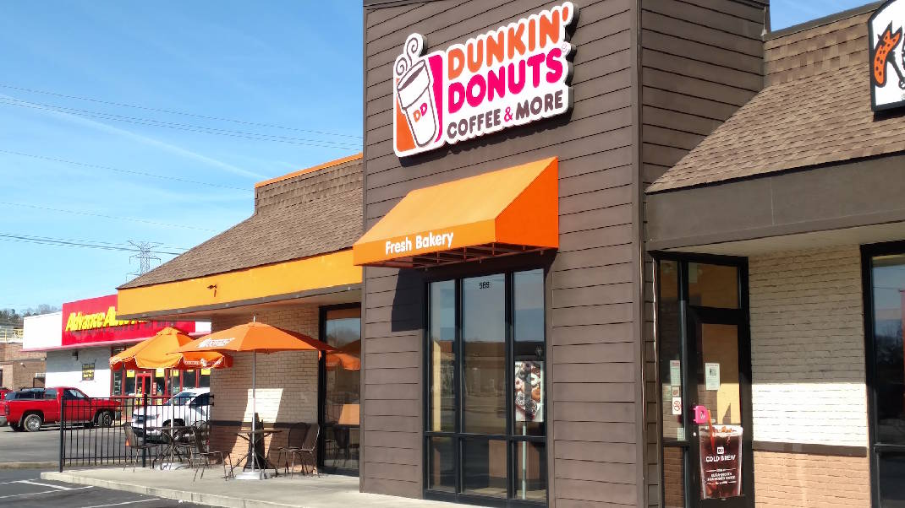
Dunkin’ Donuts
Founded in 1950
Bill Rosenberg opened the first Dunkin’ Donuts in Quincy, Massachusetts
Became a franchise just five years later
Headquarters
Canton, Massachusetts
Not far from the first shop’s location
Stores Today
Over 11,300 stores all over the world
More than 8,500 stores across the United States
More than 3,200 other locations in thirty-six different countries
Over 220 European locations as of 2015

Slide 5
Prospective competitors
Paulig Group Coffee
Market leader of coffee in Finland and the Baltics
Second greatest supplier of coffee in Russia
Over 1,900 employees in thirteen different countries
Headquarters is in Helsinki, Finland
Starbucks
Seven stores in Finland - “Third Party Store”
254,000 employees in 70 countries with almost 24,000 stores
Success in Finnish Market - international established name
Nespresso
Three stores in Finland
Geographic expansion pays dividends-tripling of the share of sales in Euro Market
Entry into the Finnish and Taiwanese markets expanded Nespresso products to almost 60 countries

Slide 6
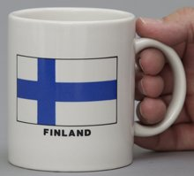
Coffee Industry in Finland
Video: Helsinki Coffee Festival
http://www.helsinkicoffeefestival.com/en/home/
Revenue
The coffee segment in Finland has amounted to approximately $502 million U.S. dollars in 2017.
Roasted coffee has generated a market volume of approximately $472 million U.S. dollars in 2017.
https://www.statista.com/outlook/30010000/135/coffee/finland#market-revenue
International Perspective
Most revenue is generated in the United States (approximately $12,836 million in 2017).
In relation to total population figures, per person revenues is approximately $90.94 U.S. dollars in 2017.
Average per capita consumption is 9.9 kg in 2017.

Slide 7
Targeting Finnish Millennials
According to research on advertising to Finnish millennials, they use Instagram, Facebook and Whatsapp the most among social media platforms.
Advertisements should focus on branding a “natural” aesthetic rather than a commercial one (like in the United States).
Focus on creating a quiet environment with lounge chairs, perhaps a coffee bar, and multiple areas to sit and have conversation.
Advertisements should capture a conversational setting and maintain a local feel.
The social media accounts should highlight Finnish culture.
https://www.youtube.com/watch?v=KHUkE8XklpQ

Slide 8
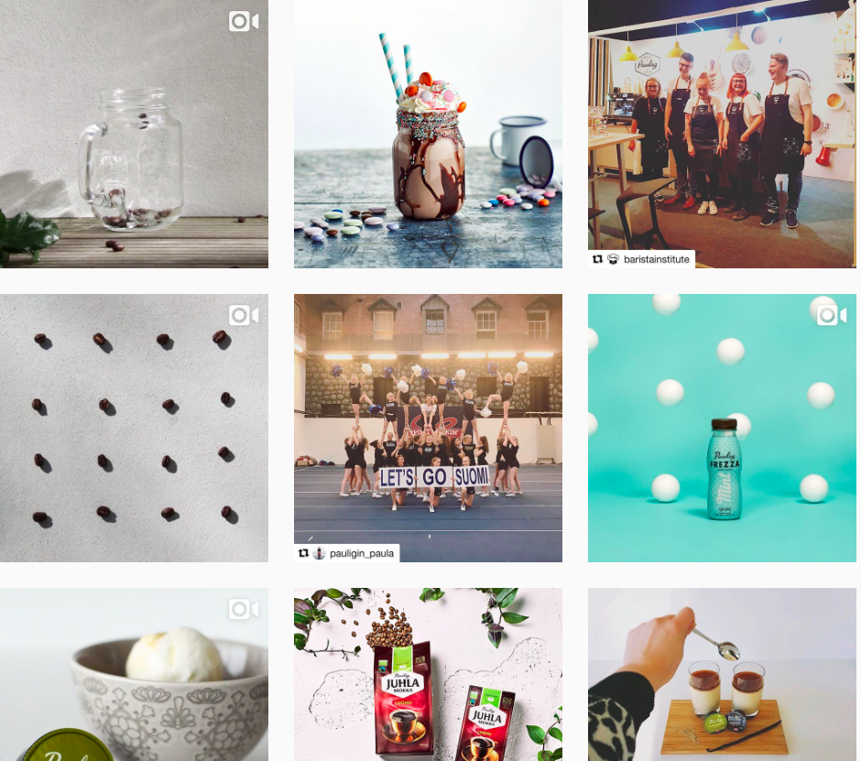
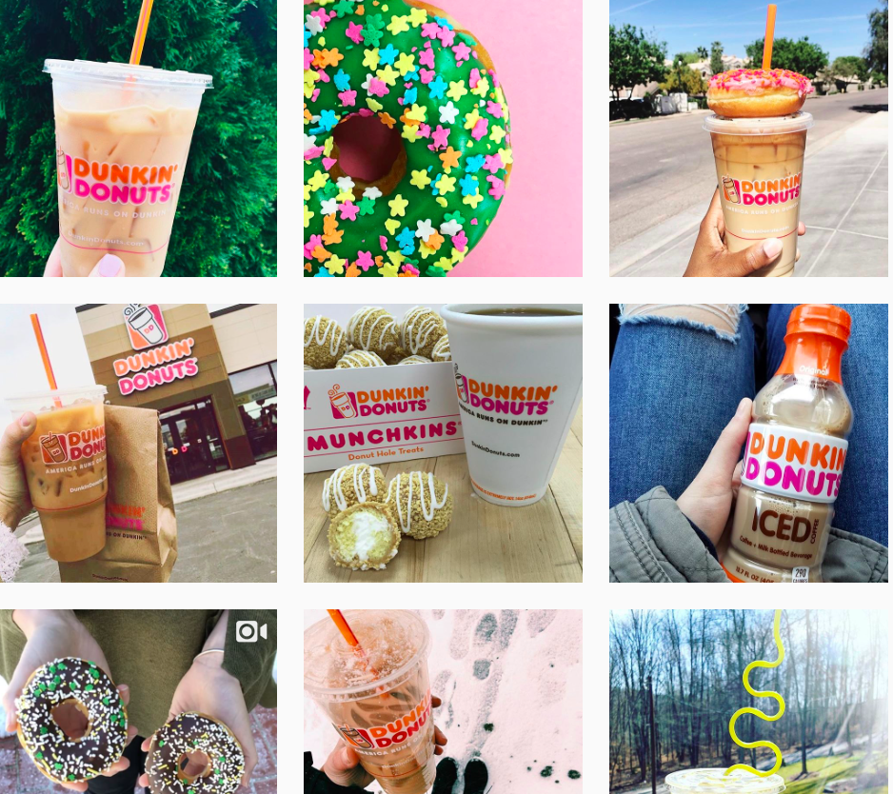
Paulig
Dunkin’ Donuts

Slide 9
SWOT Analysis
Strengths Weaknesses
3,100 stores in over 30 countries outside US High competition in European coffee industry
Innovative ways to retain customer by discounts via app Limited global recognition
Commitment to corporate social responsibility Inferior brand loyalty compared to Starbucks/Paulig
Provide food/beverage at low-cost...able to compete on price Does not brew organic coffee in-store
Opportunities Threats
Increase/change product offerings to fit Finnish consumer Rising price of coffee beans and dairy products
Capitalize on consumers’ increased desire for healthy living Market saturation
Use social media advertising to attract millennial consumers Health conscious trend among millennials

Slide 10
References
https://www.dunkindonuts.com/en/about/about-us
http://www.dunkindonuts.co.uk/global-presence/
http://www.pauliggroup.com/about-us/
https://www.statista.com/outlook/30010000/135/coffee/finland#
https://www.cbi.eu/sites/default/files/market_information/researches/product-factsheet-coffee-finland-coffee-2013.pdf
https://www.britannica.com/place/Finland
http://www.heritage.org/index/country/finland
https://finland.fi/life-society/a-guide-to-finnish-customs-and-manners/
http://expandedramblings.com/index.php/starbucks-statistics/

